Slide 1
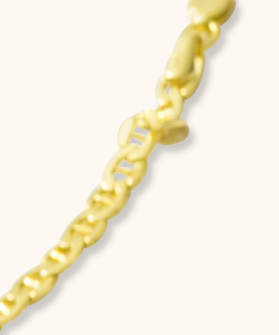
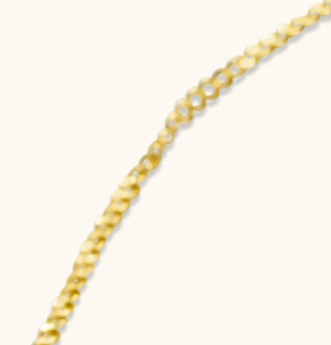
General Comments
We don’t want to see the blur parts of the products at the center. For this reason please focus on clean and sharpen parts of the products, and create the retouched photos by positioning all the products at the center of the square and vertical photos. In case of any need, you can crop the photos accordingly
We don’t want to see the chain parts which are bended or damaged. Please crop these parts. (Example below.)

Slide 2
WEB (6)
We don’t want to see the blur parts of the products at the center. For this reason please focus on clean and sharpen parts of the products, and create the retouched photos by positioning all the products at the center of the square and vertical photos.
The area in the red circle needs to be revised. The color-tone of this area is not the same as the other parts of the chain

Slide 3
WEB (14)
We don’t want to see the blur parts of the products at the center. For this reason please focus on clean and sharpen parts of the products, and create the retouched photos by positioning all the products at the center of the square and vertical photos.

Slide 4
WEB (15)
We don’t want to see the blur parts of the products at the center. For this reason please focus on clean and sharpen parts of the products, and create the retouched photos by positioning all the products at the center of the square and vertical photos.

Slide 5
WEB (17)
We don’t want to see the blur parts of the products at the center. For this reason please focus on clean and sharpen parts of the products, and create the retouched photos by positioning all the products at the center of the square and vertical photos.
Please reduce the black tones on the chain.
Tone of the gold is close to green-yellow. It should be same as yellow as the other product photos

Slide 6
WEB (18)
This is the same chain, named web(17) but the only difference is, this one is a little thinner than web (17)
When you finish the previous chain (document name: web 17) please copy that image and photoshop it by thinning the thickness of the product.

Slide 7
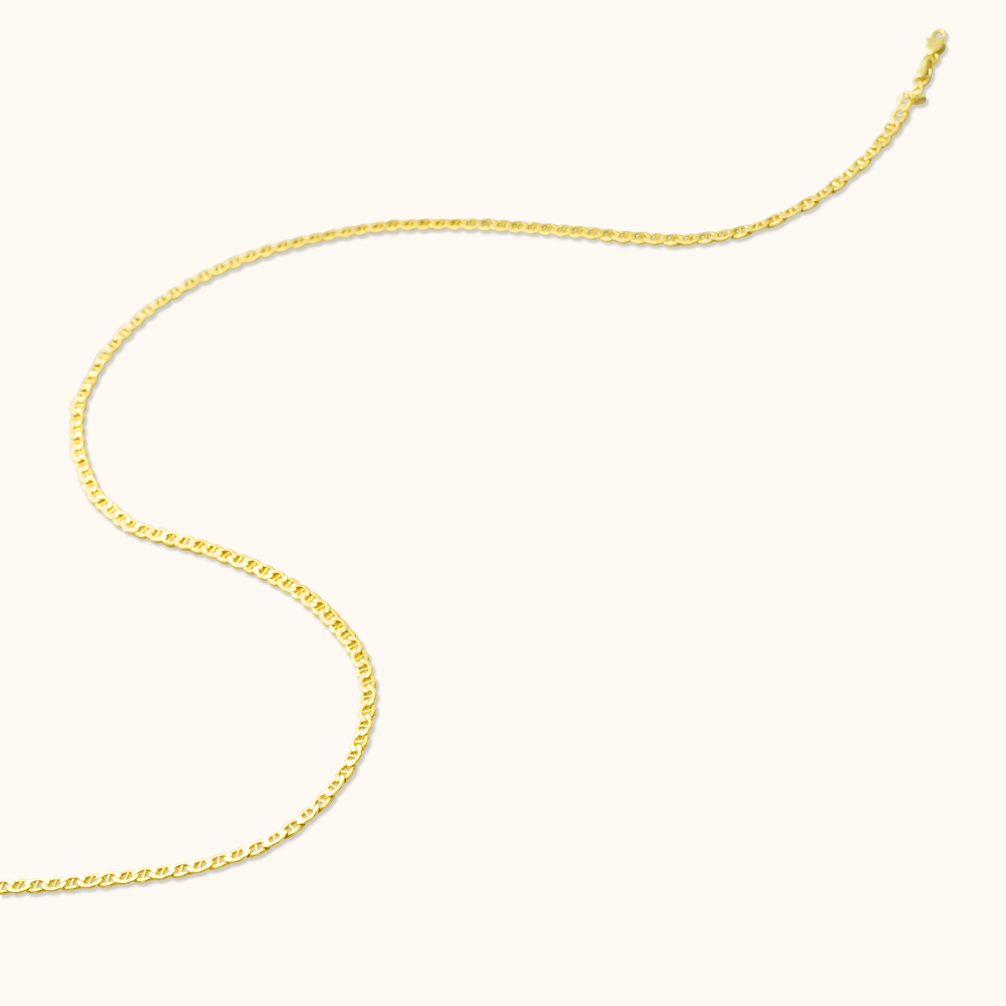
WEB (19)
We don’t want to see the blur parts of the products at the center. For this reason please focus on clean and sharpen parts of the products, and create the retouched photos by positioning all the products at the center of the square and vertical photos.
We don’t want to see the chain clips and the the parts which are bended or damaged.

Slide 8
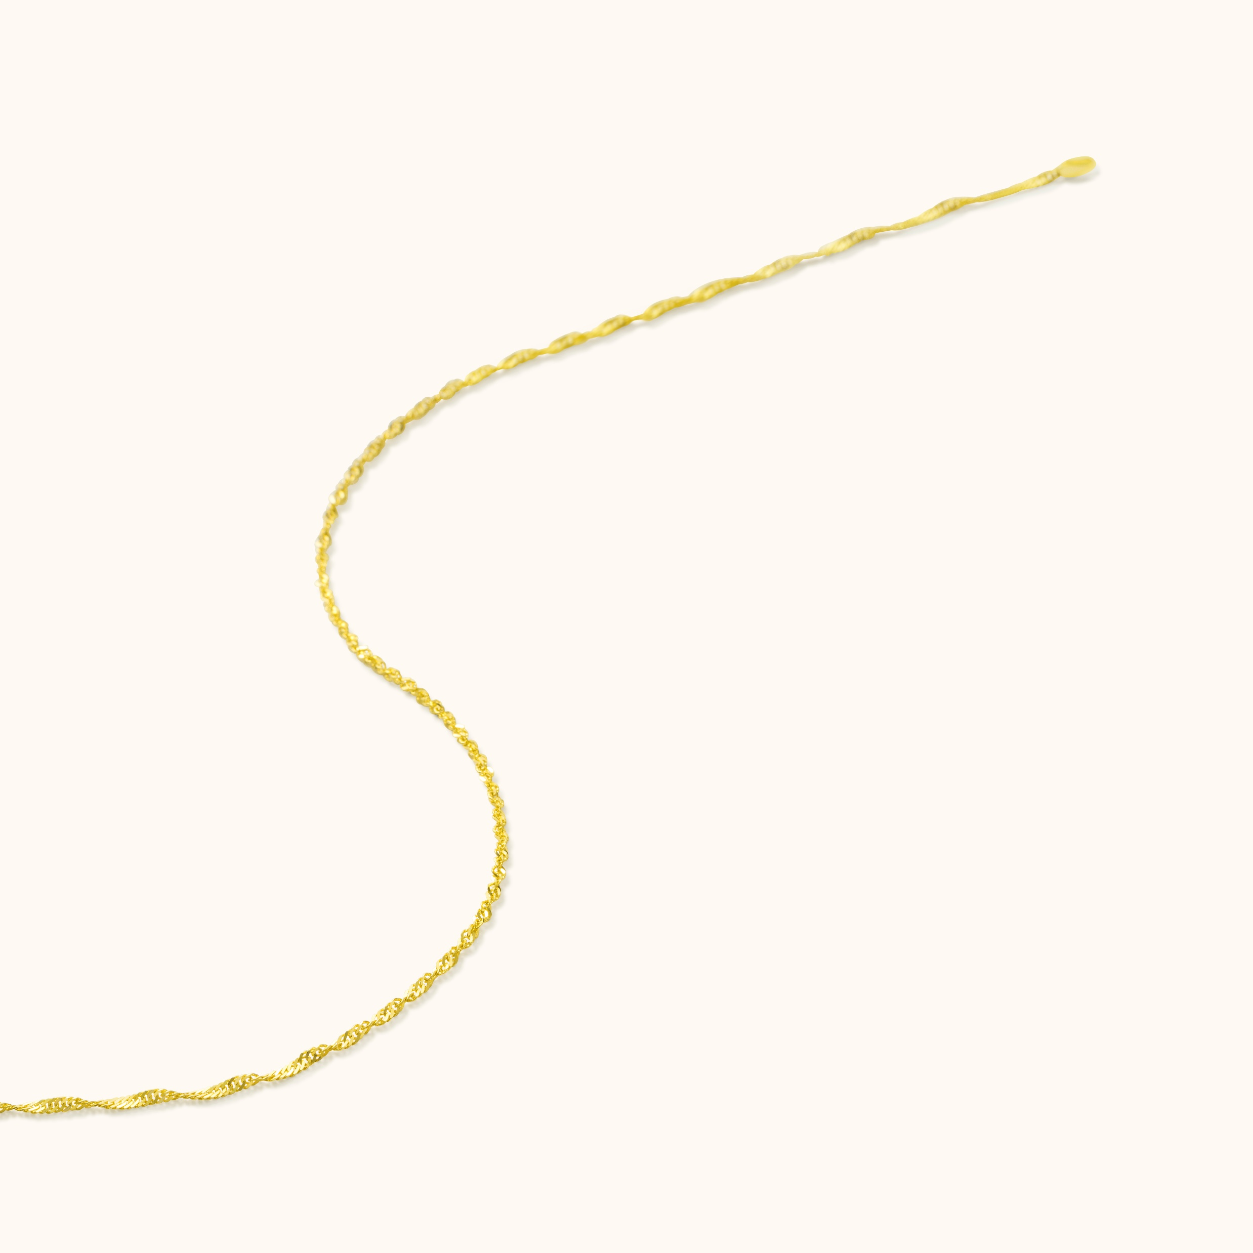
WEB (20)
We don’t want to see the blur parts of the products at the center. For this reason please focus on clean and sharpen parts of the products, and create the retouched photos by positioning all the products at the center of the square and vertical photos.
We don’t want to see the chain clips and the the parts which are bended or damaged.

Slide 9
WEB (21)
We don’t want to see the blur parts of the products at the center. For this reason please focus on clean and sharpen parts of the products, and create the retouched photos by positioning all the products at the center of the square and vertical photos.

Slide 10
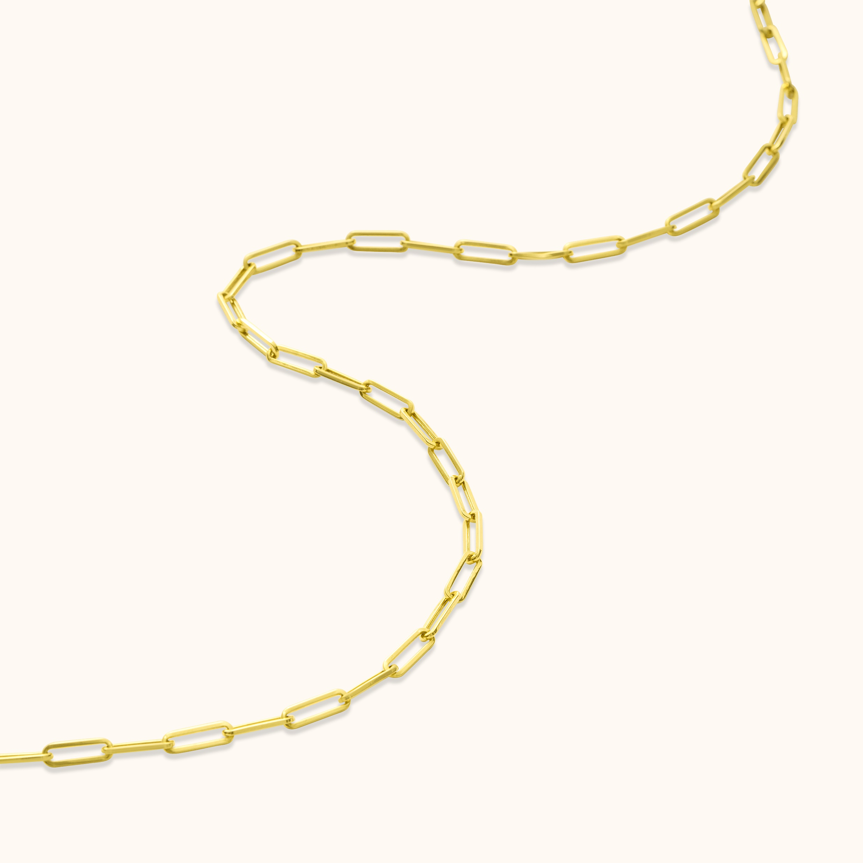
WEB (24)
We don’t want to see the blur parts of the products at the center. For this reason please focus on clean and sharpen parts of the products, and create the retouched photos by positioning all the products at the center of the square and vertical photos.

Slide 11
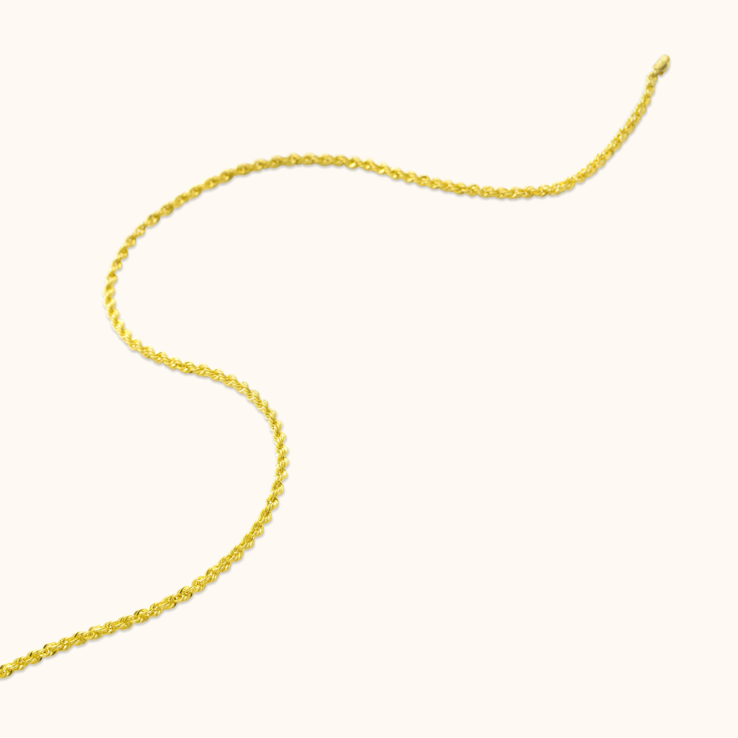
WEB (26)
We don’t want to see the blur parts of the products at the center. For this reason please focus on clean and sharpen parts of the products, and create the retouched photos by positioning all the products at the center of the square and vertical photos.
We don’t want to see the chain clips and the the parts which are bended or damaged.

